Slide 1
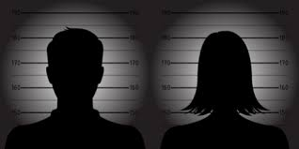
Criminal Profiling

Slide 2
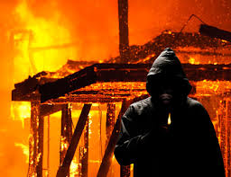
Areas where Criminal Profiling is effective
Criminal profiling is defined as an investigative strategy employed to determine the perpetrator of a crime by relating the offender's behavioural traits and personality based on analysis of the offence that has been committed (Turvey, 2020).
The following are three areas where criminal profiling is effective;
Identification of arsonists
Identification of sexual murderers
During a hostage negotiation
Profiling is effective in aiding investigators to comprehend their cases further.
Profiling is effective in identifying patterns of an offender, thus making it easier to capture them.
Notes:
Criminal profiling is an investigative procedure where profilers attempt to identify a violent crime offender by relating the crime to the offender's personality and behaviour oral traits. Criminal profiling is effective in the following three main areas; hostage negotiation cases, sexual murder offences, and arson cases. Criminal profiling effectively assists the investigators in narrowing down on the actual perpetrator of the crime by determining their specific attributes. Criminal profiling also enables the investigators better to comprehend a violent case in terms of motive, thus making it easier to solve.

Slide 3
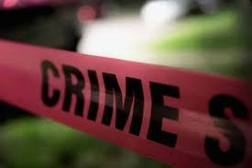
Elements of cases that would benefit from Criminal Profiling
Cases that involve violence such as arson, rape or sexual murders.
Cases where the perpetrator does not leave behind any evidence at the crime scene.
Cases that seem to have a similar pattern, such as the same trophies are left behind, and all victims narrate a similar story (Francese,2019).
Cases where the list of suspects is too long.
Cases where the perpetrator is believed to be the same person
Cases where the crime scenes have the same geographical setup.
Notes:
There are certain elements of cases that would benefit from criminal profiling. The first element is cases that have a long list of suspected perpetrators. The second element is cases with similar crime scenes in terms of the setup or environment; the third element involves cases involving violence such as rape, arson, or sexual murders. The fourth element is crimes that investigators predict to have been performed by the same offender. The fifth element is cases where crime patterns are similar, such as victims offering the same occurrence of events. The sixth and final element is crimes which are performed in a similar geographical location.

Slide 4
Ways to improve effectiveness of Criminal Profiling
The profilers should sharpen their critical thinking skills to improve their assessments and conclusions in profiling cases.
Geographical profilers should sharpen their geographical location abilities.
Profilers should also strive to sharpen their psychological skills
Profilers should strive to improve their investigative skills to solve the cases fast before the perpetrators do too much harm.
The profilers should seek to better their questioning skills so that the victims feel comfortable enough to reveal all vital information about the offender.
Notes:
There are various ways to better the effectiveness of criminal profiling. Some of the ways of doing so include; encouraging the profilers to find means of sharpening their critical thinking skills so they can be more accurate in their conclusions in cases, the other way of making criminal profiling more effective is educating profilers on question skills so that in cases where victims are involved they can make the victims comfortable enough to share all relevant information without being too invasive. The profilers should also be educated on psychology so they can be able to accurately relate the offenders past with the present and draw possible motives of the offender. In addition, geographical profilers should take courses in geography to improve their locating abilities further.

Slide 5

Limitations and Solutions of Criminal Profiling
The methods of criminal profiling are minimal. This means that if a case does not fall within the existing methods, there are high inaccuracy chances.
Criminal profiling is based on specific routines. An offender is less likely to follow a similar pattern in performing crimes because they know the authorities are after them (Balogun & Zuva, 2018)
Most times, the profilers' data is found to be false, and thus investigators find themselves in a tough spot when they follow up on the wrong people.
Profiling works based on educated assumptions and not facts about the offender
Criminal profiling should strictly be done based on the facts that are available.
There should be other profiling methods developed to widen the scope for investigating violent criminal cases.
Notes:
There are a number of limitations in criminal profiling. The methods available for criminal profiling are limited (only seven), which means that if a case falls out of the existing methods, then the chances of solving the case correctly are minimal. The other limitation is that criminal profiling is solely based on an educated assumption that does not necessarily mean that the data used is factual. Criminal profiling heavily relies on consistency; the profilers assume that the offender will follow the same pattern repeatedly, but this may not be the case because they are already aware that the authorities are trying to capture them. The other very significant flaw of criminal profiling is that the profilers tend to be inaccurate in their predictions in most cases. This means that the police may mishandle certain individuals they believe in having done a crime due to the false data. The solutions for such limitations include basing criminal profiling on facts available other than assumptions and developing more alternative criminal profiling methods so that the scope for solving violent crimes is wider.

Slide 6
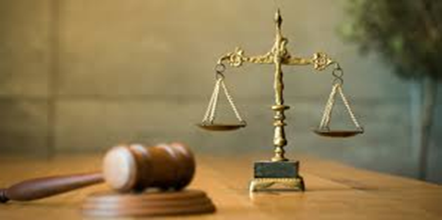
How can the limits be changed?
Since criminal profiling is not well developed other alternatives can be used instead namely;
Mental diagnostic evaluations offered by health professionals
Investigations by psychologists that show the past and present of an offender
Nomothetic which involves looking at universal laws and groups (Garcia,2018)
Idiographic which involves an analysis of an individual's qualities
Using organized or disorganized typology to determine whether a crime is planned or just spontaneous.
Notes:
The limits for criminal profiling can be changed by adopting certain alternatives such as; conducting mental diagnostic evaluations with the help of certified health professionals, psychiatric investigations to verify the past and present of offenders and the motive for doing the crimes, Nomothetic procedures that involve looking into universal laws and groups, idiographic that establish the specific qualities of an individual and also using either organized or disorganized typology to determine whether a crime was planned or it was done spontaneously.

Slide 7
References
Turvey, B. E. (Ed.). (2020). Criminal profiling: an introduction to behavioural evidence analysis. Academic Press.
Francese, S. (2019). Criminal profiling through MALDI MS-based technologies–breaking barriers towards border-free forensic science. Australian Journal of forensic sciences, 51(6), 623-635.
Garcia, N. (2018). The use of criminal profiling in cybercrime investigations (Doctoral dissertation, Master's Thesis). Available from ProQuest Dissertations & Theses Global database. (Accession Order No. AAT 10839020)).
Balogun, A. M., & Zuva, T. (2018, December). Criminal Profiling in Digital Forensics: Assumptions, Challenges and Probable Solution. In 2018 International Conference on Intelligent and Innovative Computing Applications (ICONIC) (pp. 1-7). IEEE.

